Slide 1
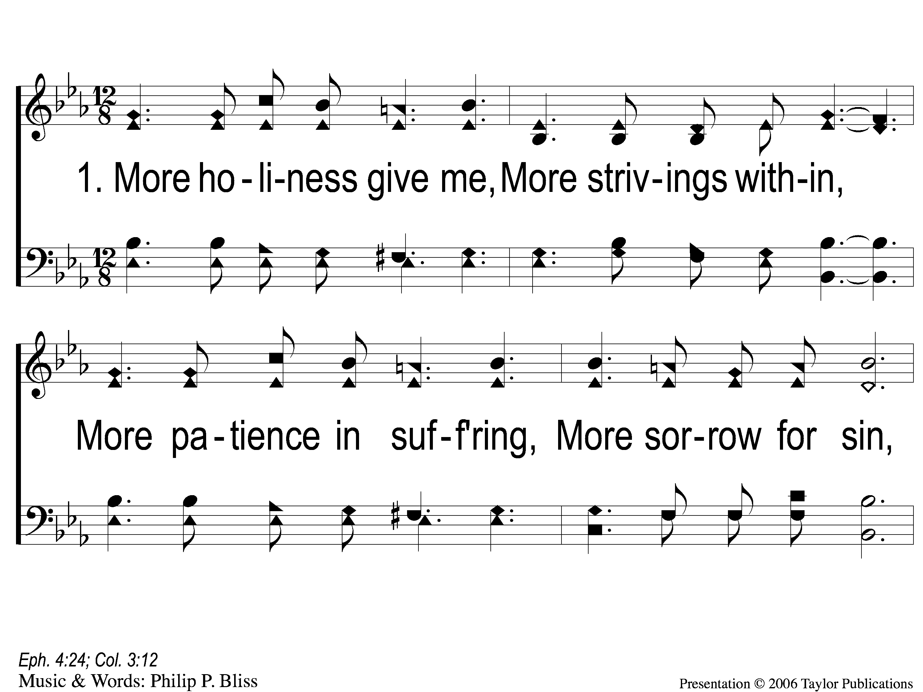
1-1 More Holiness Give Me
More Holiness Give Me
109

Slide 2
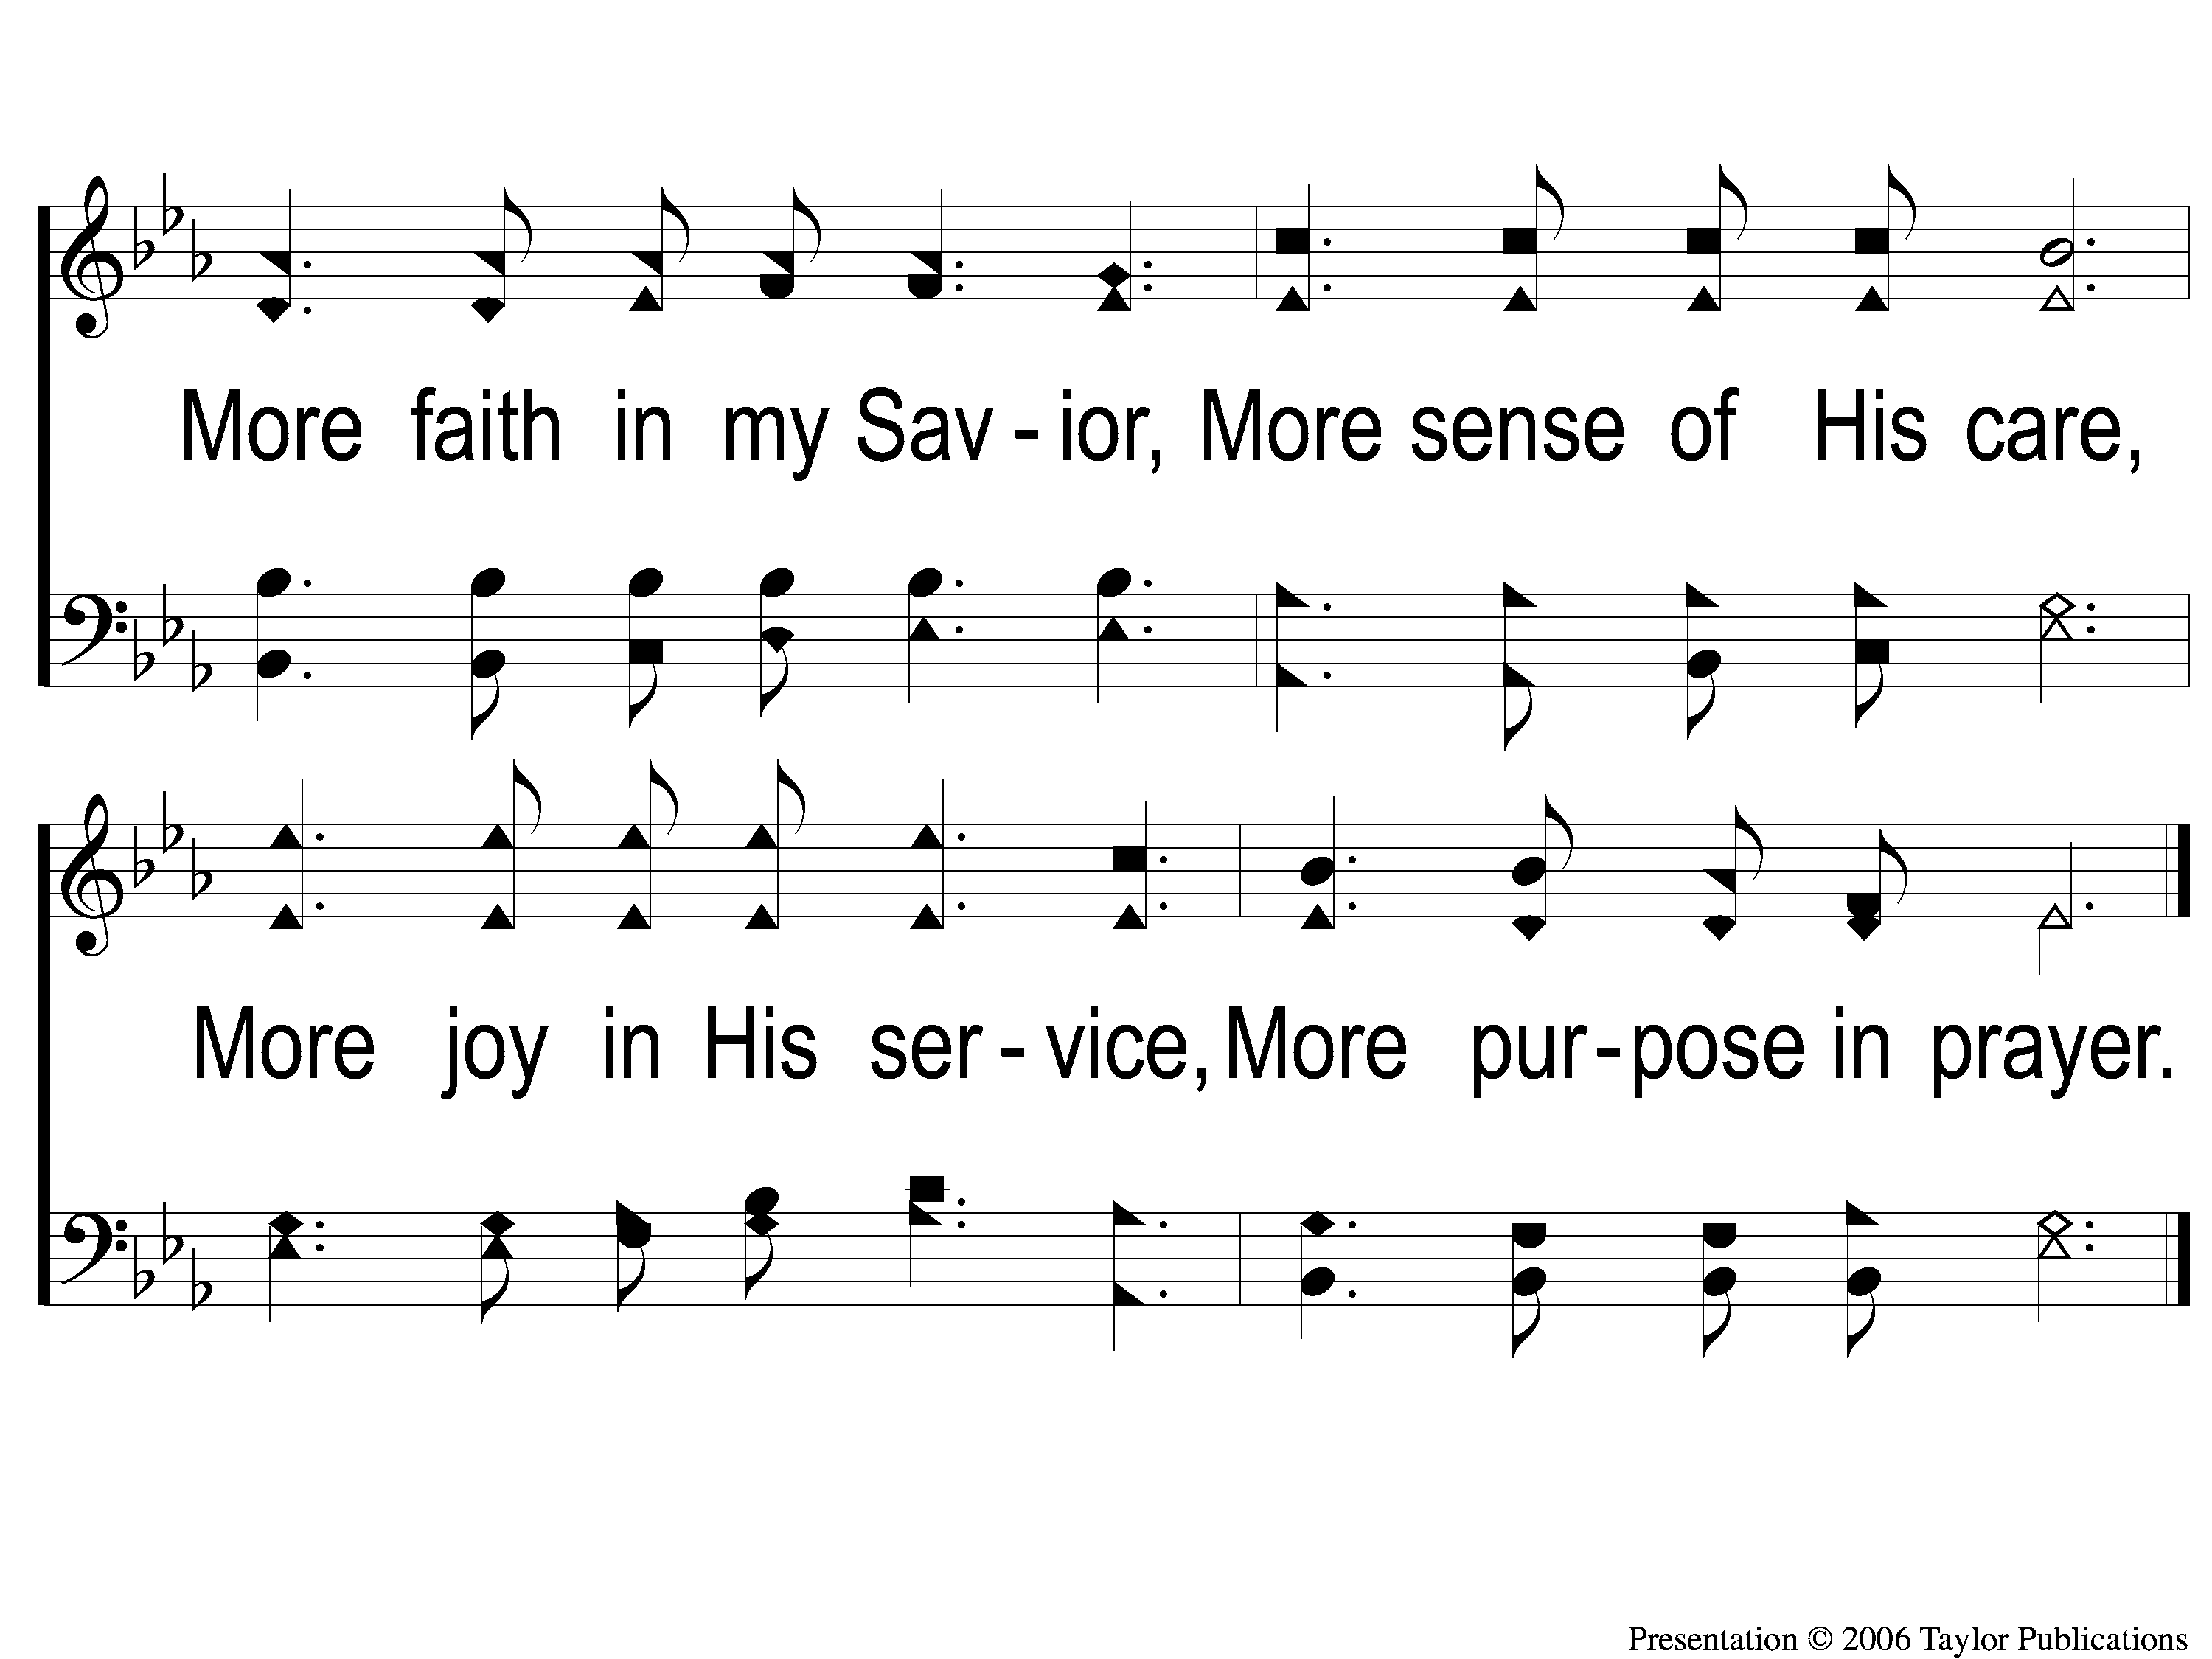
1-2 More Holiness Give Me
More Holiness Give Me
109

Slide 3
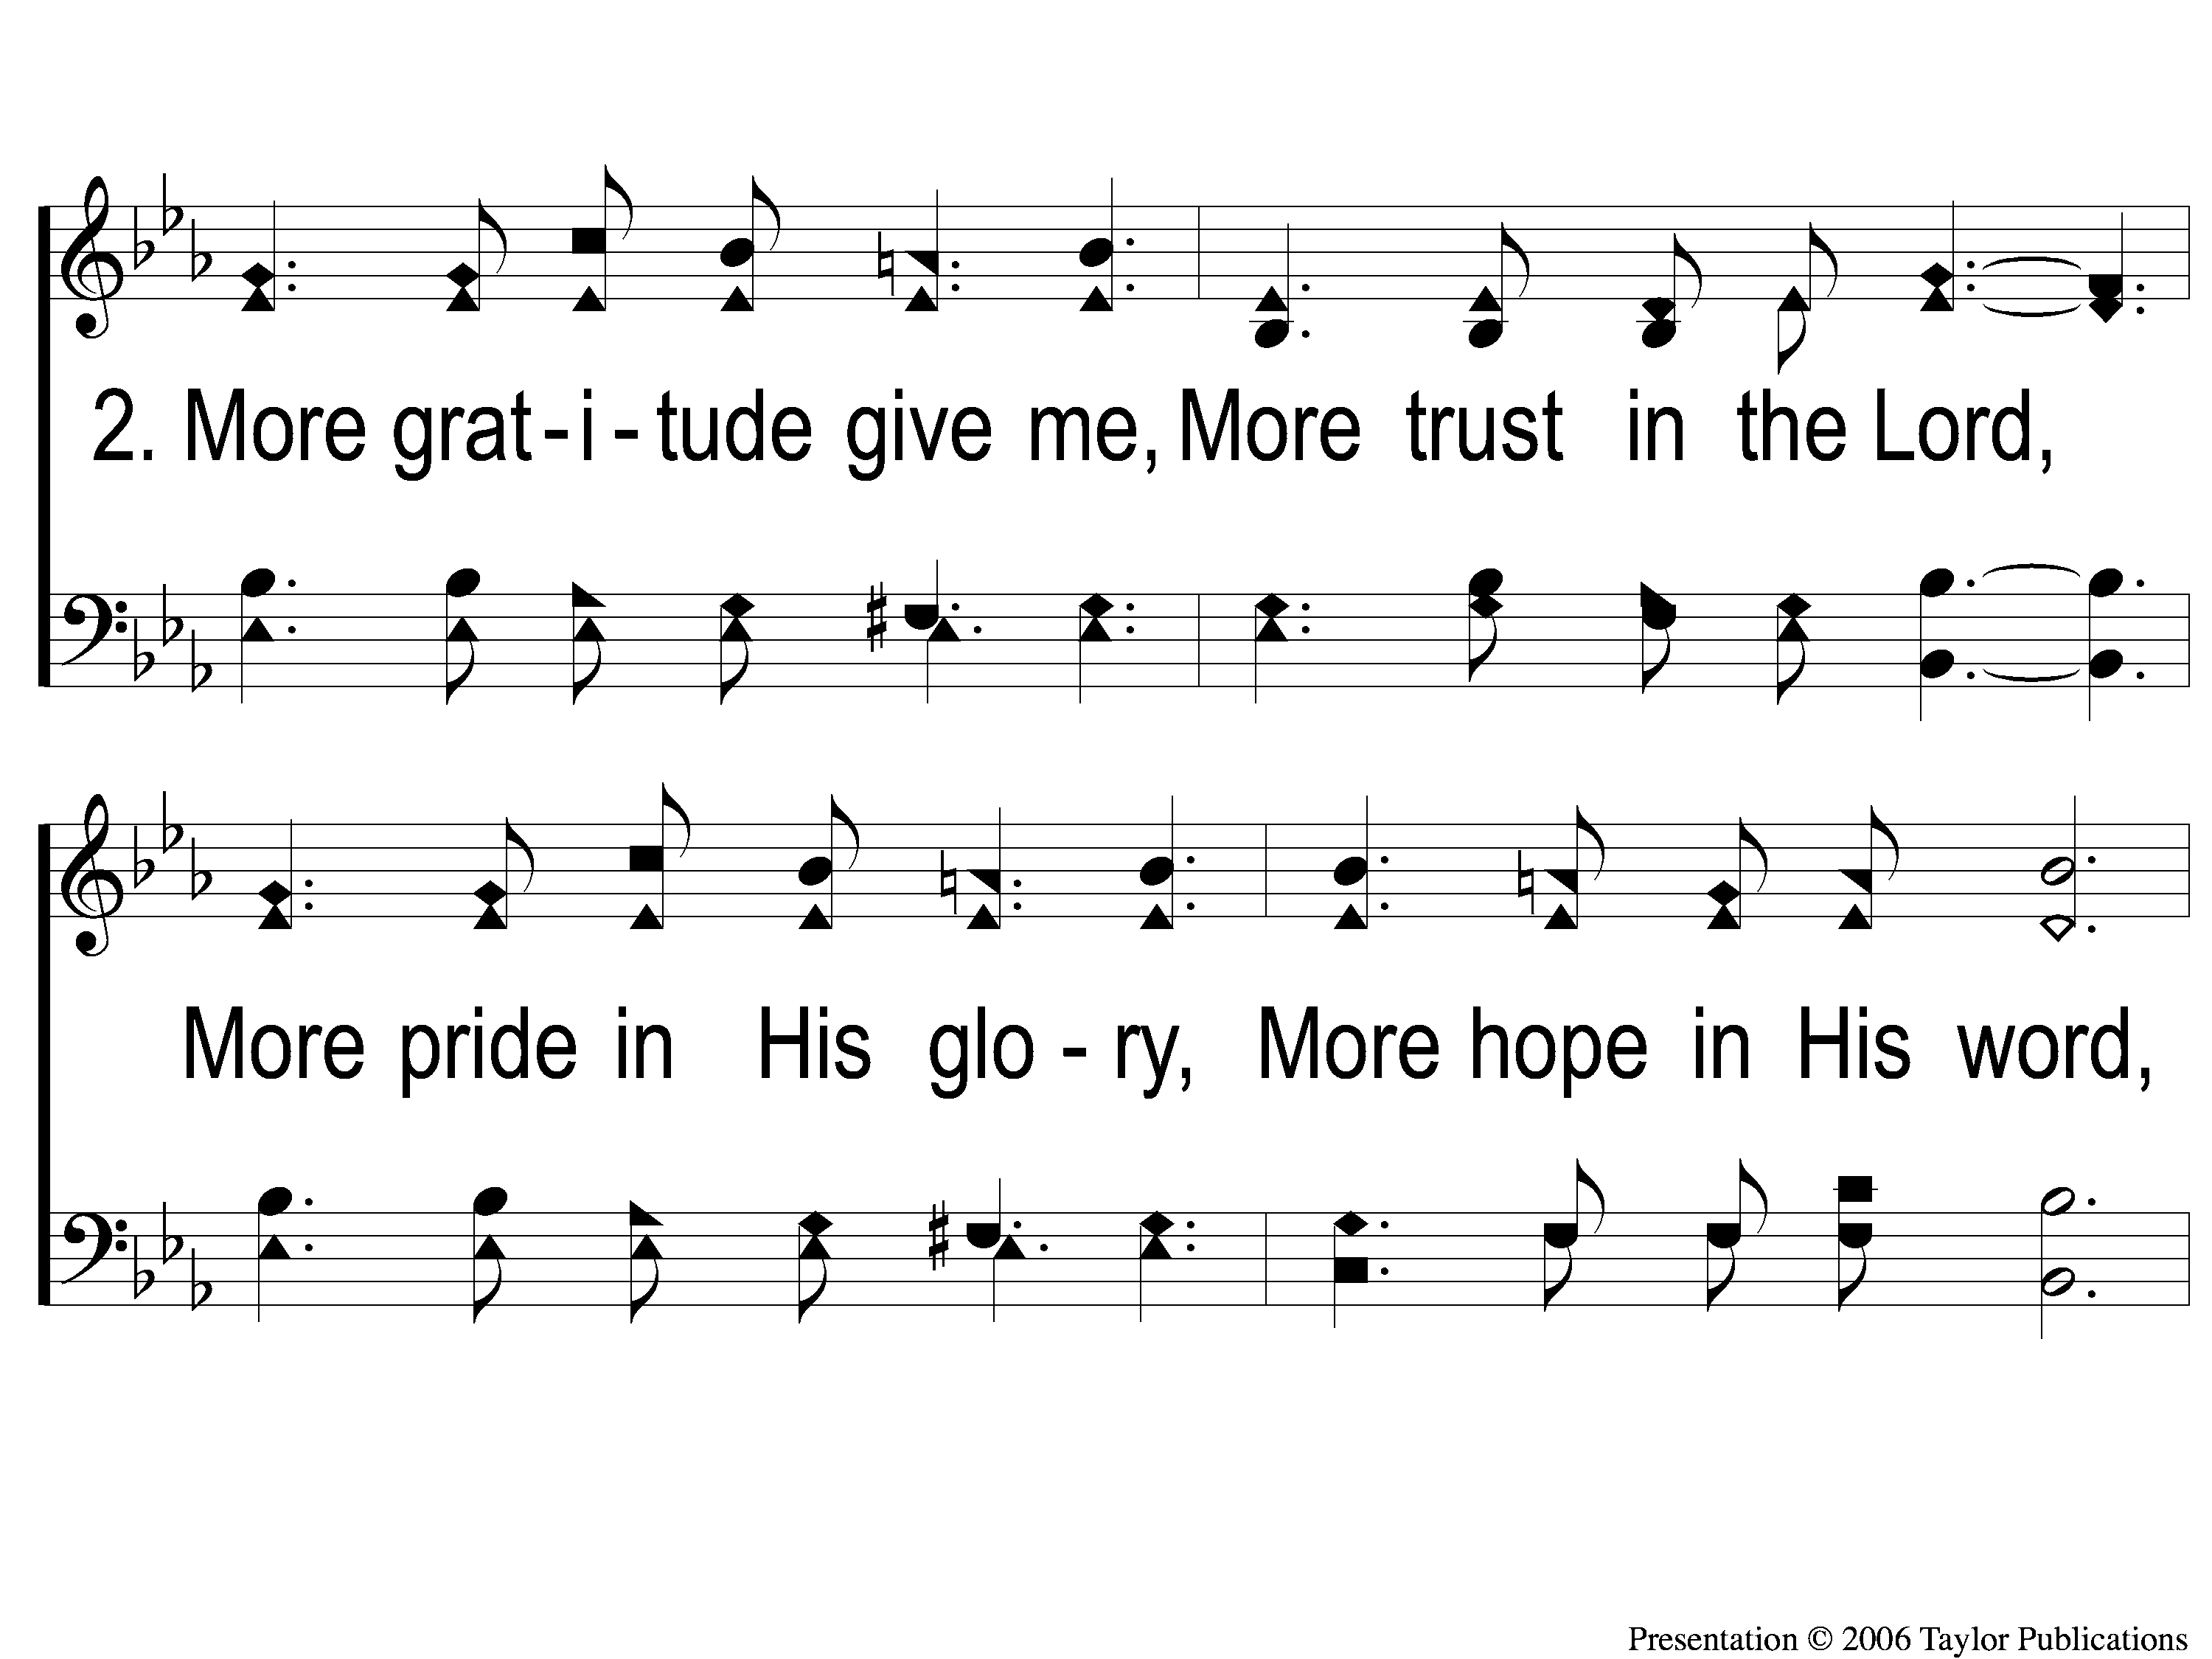
2-1 More Holiness Give Me
More Holiness Give Me
109

Slide 4
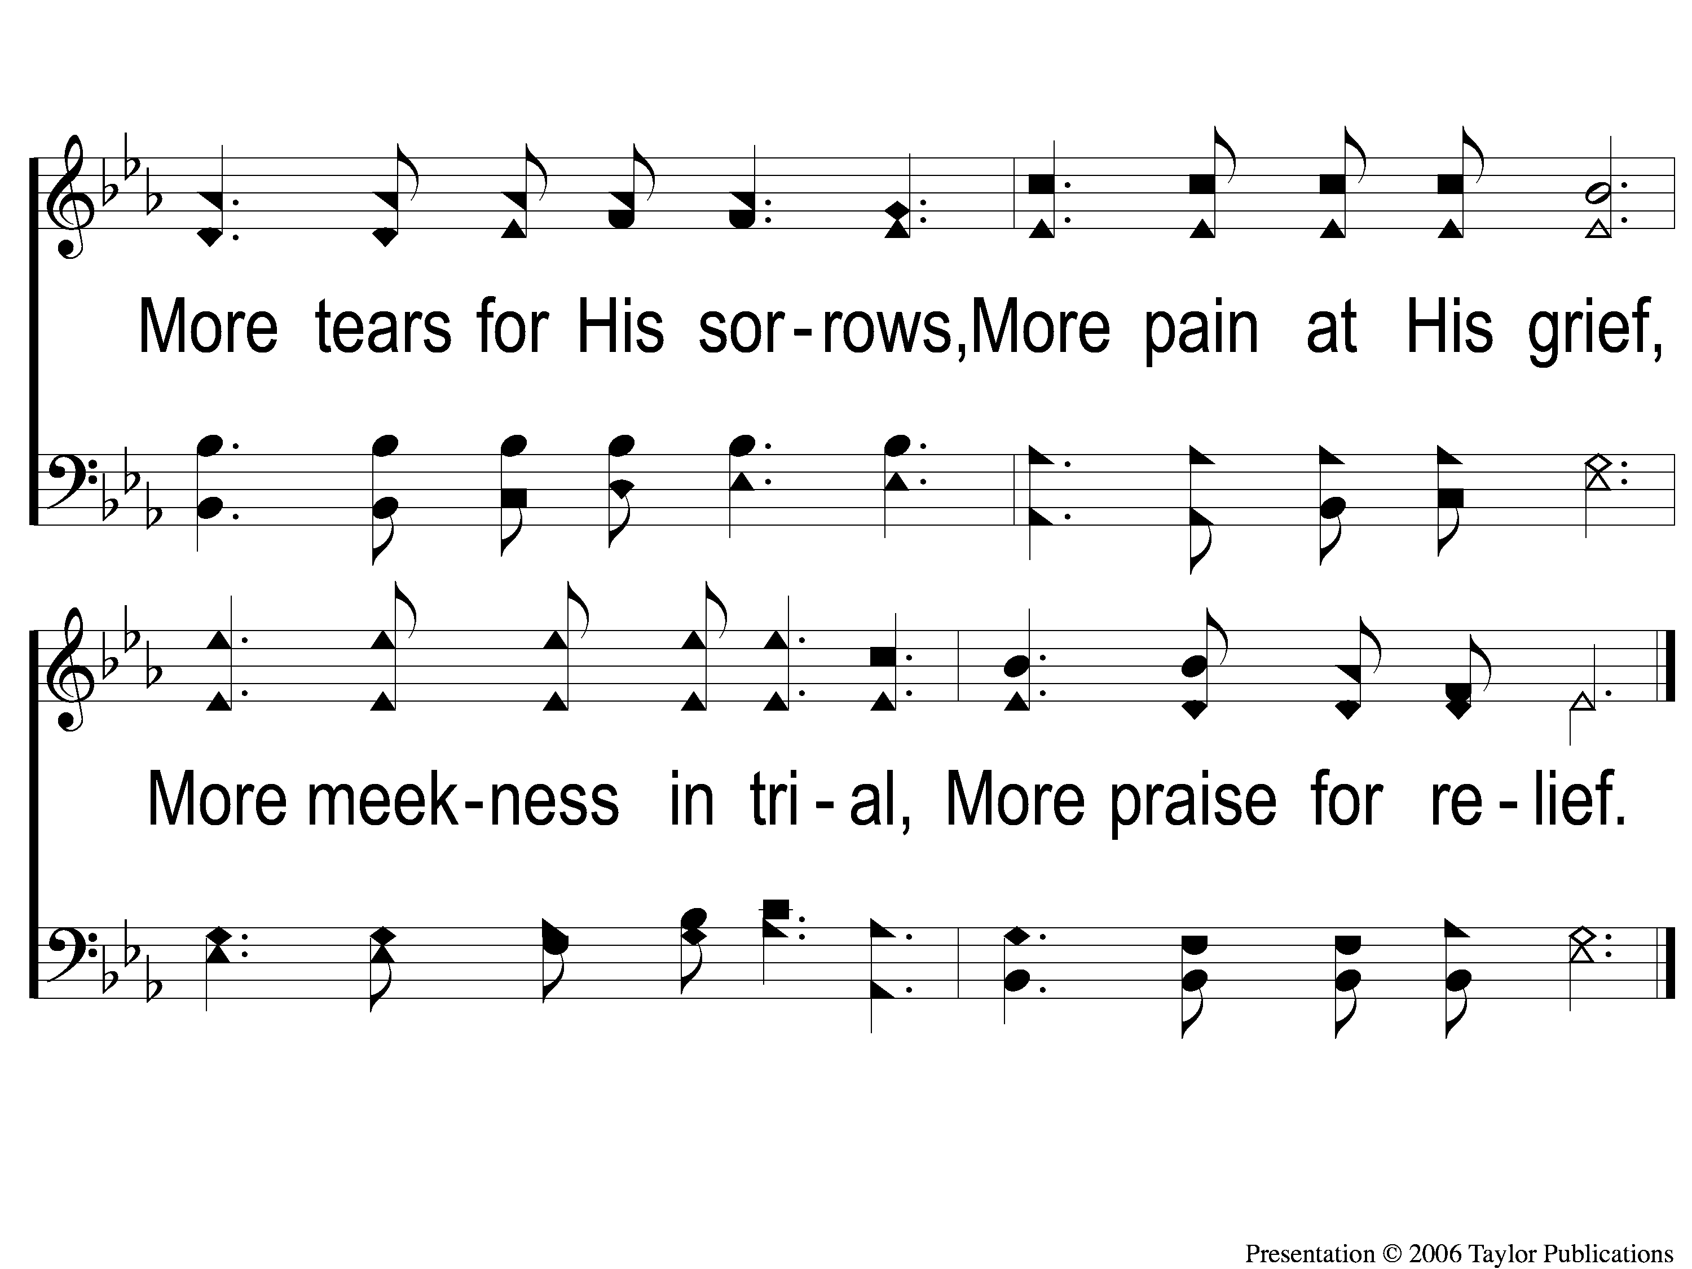
2-2 More Holiness Give Me
More Holiness Give Me
109

Slide 5
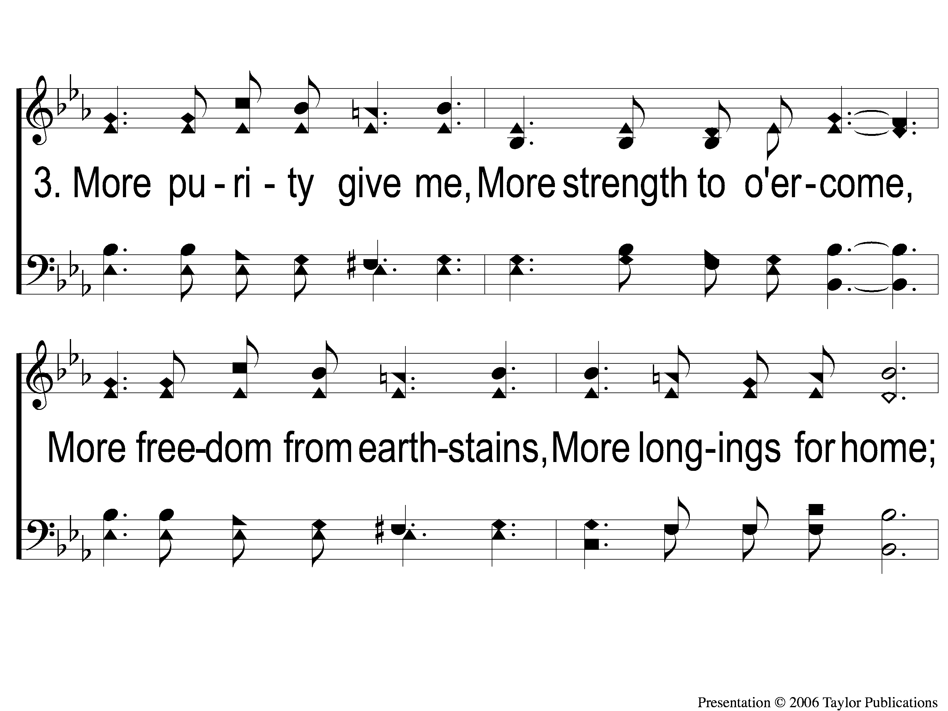
3-1 More Holiness Give Me
More Holiness Give Me
109

Slide 6
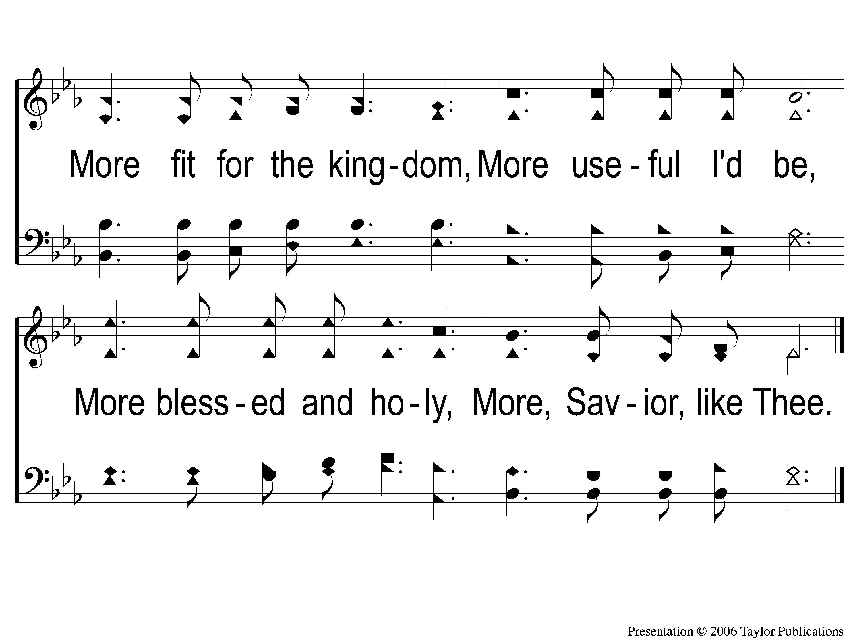
3-2 More Holiness Give Me
More Holiness Give Me
109

